Slide 1
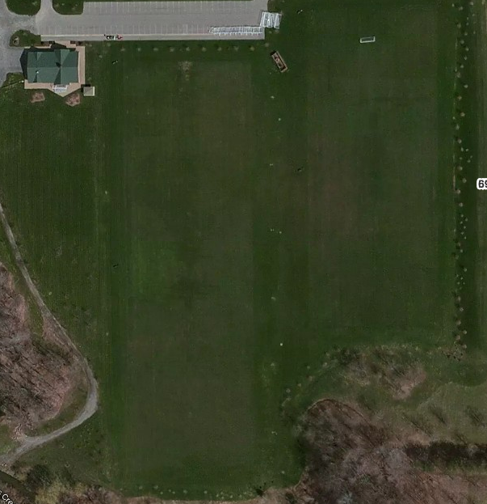
Parking
LITTLE KICKERS
Group
1
Group
2
Group
3
Group
4
6909 Milestrip

