Slide 1
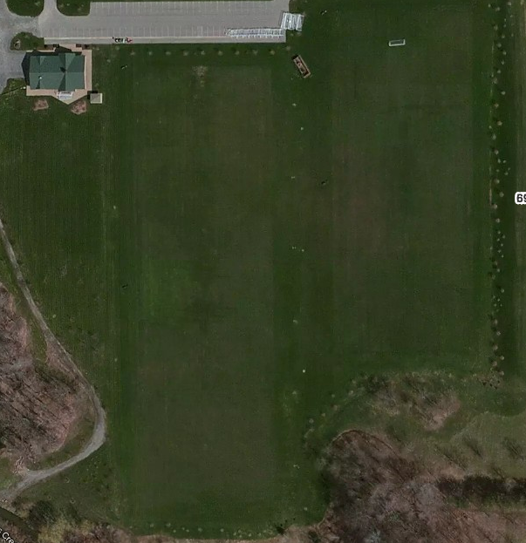
Parking
LITTLE KICKERS
Group 1 Group 2 Group 3 Group 4
Goalkeeper Summer Soccer School
5:30 to 6:30
6909 Milestrip

