Slide 1
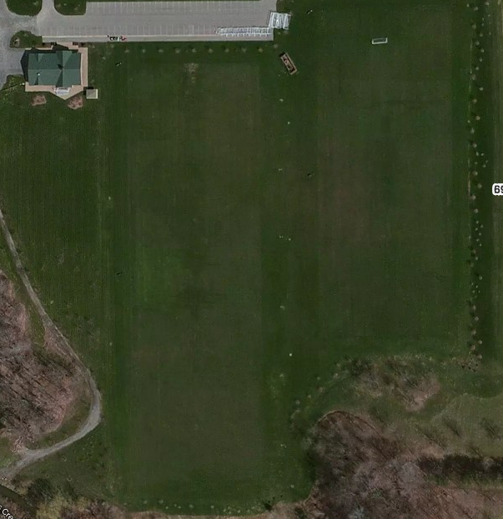
Parking
Field
1
1
10
Field
4
2
9
3
8
Field 2
4
7
5
6
Field 3
Field
6909 Milestrip

Slide 2
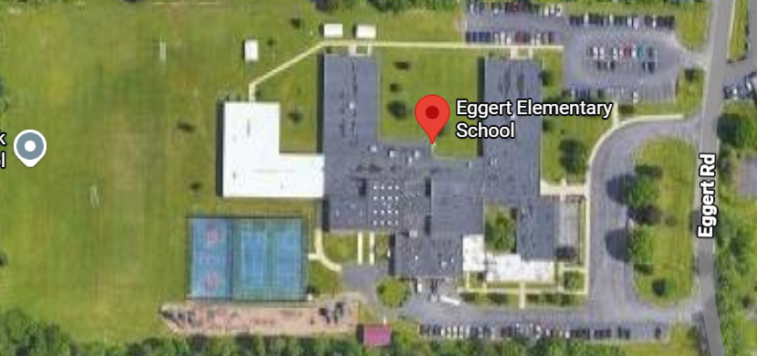
Field 2
Field 3
u10 (6/16 and 6/23) and u12 (6/17 and 6/24) weekday games only
3580 Eggert Road

